Slide 1
Week 8
Alexey V. Zimin
JHU BME 580.417/707

Slide 2
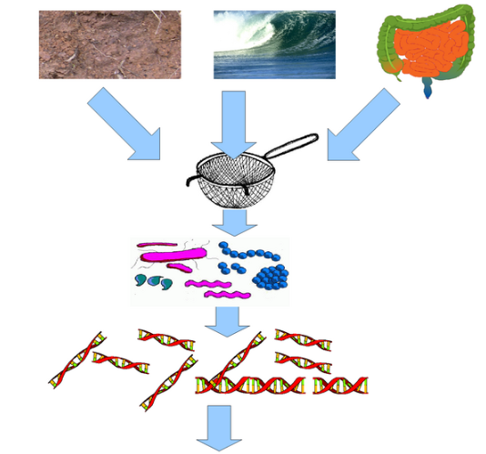

Metagenomic data analysis
In a typical genome project you want to sequence DNA from a single organism
Metagenomic data is sequenced from a sample intentionally containing many species (many of them unknown)
Important for studying composition of microorganisms (bacteria of fungus), diagnostics of diseases
https://www.neurology.org/doi/10.1212/NXI.0000000000000251

Slide 3
Characteristics of metagenomic data
Typically short reads (Illumina)
Number of species: unknown
Coverage of each species: unknown
Assembly possible? Maybe, but similar species can assemble together forming chimeric contigs
Preferred mode of analysis: K-mers

Slide 4
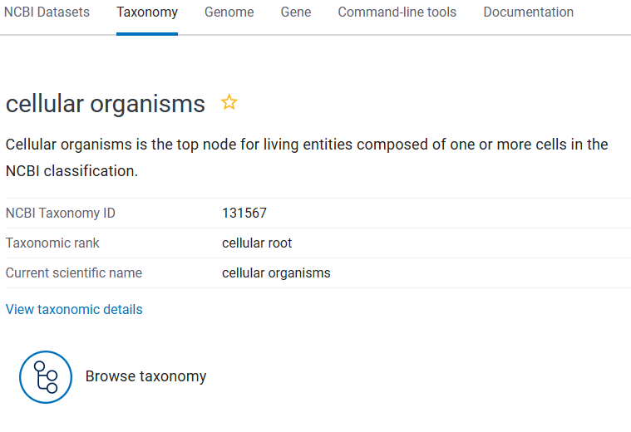
NCBI Taxonomy
The Taxonomy Database is a curated classification and nomenclature for all organisms in the public sequence databases.
This currently represents about 10% of the described species of life on the planet.
These species are part of NCBI Taxonomy tree. Each node on the tree has a numerical ID.

Slide 5
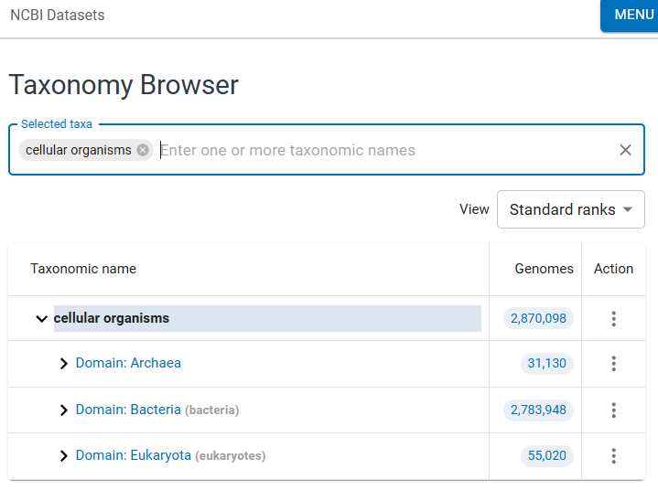
NCBI Taxonomy Browser
By browsing the taxonomy tree one can find all known species, their ID and known evolutionary relationships
DEMO

Slide 6
Analysis of metagenomic data
High resolution: KrakenUniq:
Build database of all k-mers in a set of species to be classified
Attach Taxonomic ID to each K-mer
Use the lowest common ancestor’s ID
Examine all k-mers in reads from metagenomic sample
Determine what Tax IDs are present
Databases are BIG!

Slide 7
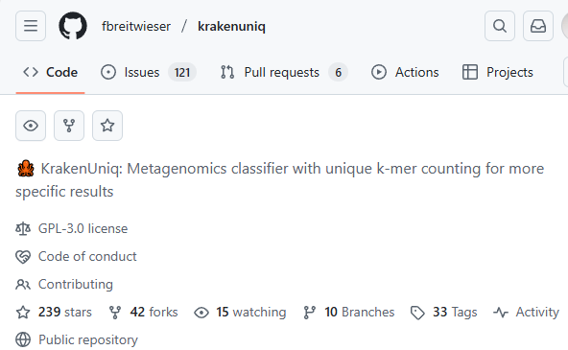
Analysis of metagenomic data
High resolution: KrakenUniq:
Build database of all k-mers in a set of species to be classified
Attach Taxonomic ID to each K-mer
Use the lowest common ancestor’s ID
Examine all k-mers in reads from metagenomic sample
Determine what Tax IDs are present
Databases are BIG!

Slide 8


Why Uniq in KrakenUniq?
NOT IN the sample due to repeat or contamination
IN the sample
Species 1
Species 2

Slide 9
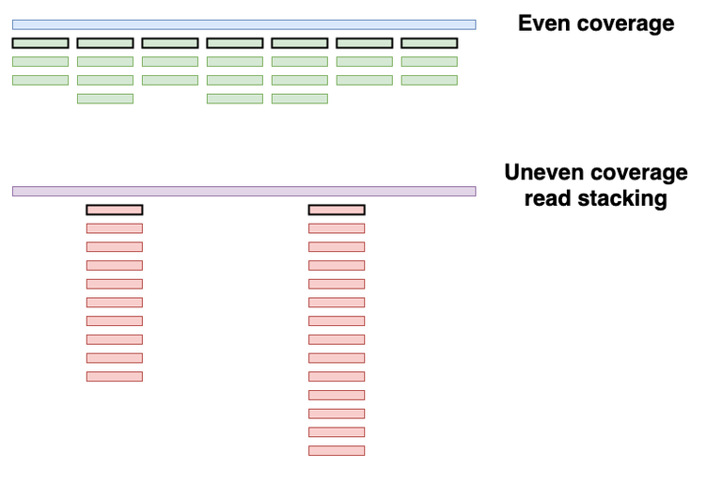
Even vs. Uneven coverage
Credit:https://maximeborry.com/post/kraken-uniq/
7 reads, low duplication ratio
2 reads, high duplication ratio

Slide 10
Analysis of metagenomic data
WARNING! Contamination!
Species detected != It is in the sample
Lab contamination
Illumina sequencing chemicals have contaminants in them
Sample collection contamination
Can run control sample to eliminate contamination
Add human to database to avoid classifying contaminated genomes
KrakenUniq DEMO https://www.ncbi.nlm.nih.gov/sra/?term=ERR15403501

Slide 11
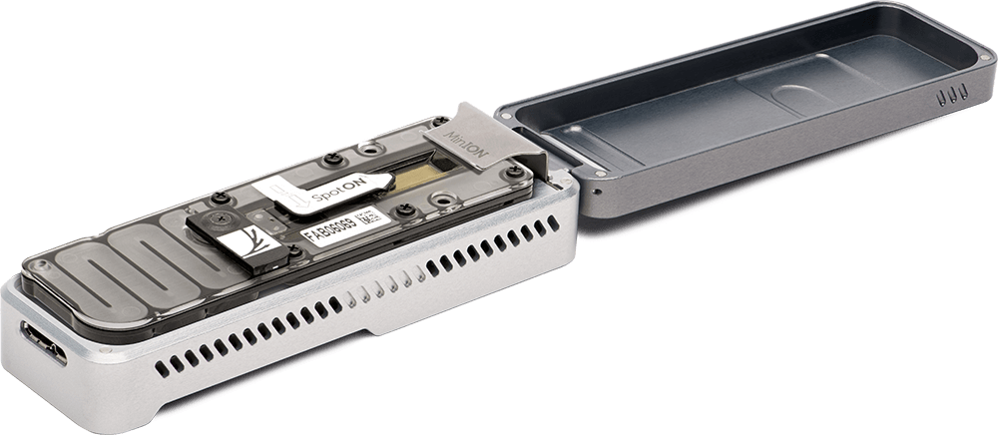
Long-read metagenomics
Long read sequencing is getting cheaper -> can use them for metagenomic samples
ONT MinION is portable – can take it into the field
Each read yields more K-mers
Create database of sketches or minimizers in genomes
Use minimizers with large window size – number or minimizers proportional to each genome size, or
Use fixed size sketches
Assign the Tax ID of the lowest common ancestor to each K-mer

Slide 12
Making sense of genomic sequence
We assembled the genome – what is next?
We can identify functionally important elements (subsequences):
Genes
Protein coding regions
Regulatory elements
This is called genome annotation
Genome annotation provides coordinates (start, stop and strand) and identifies function of functional elements in the genomic sequence

Slide 13
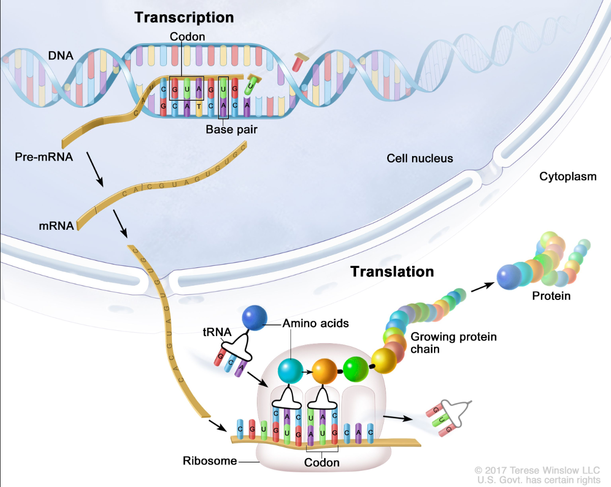
How transcription + translation works?
Transcription and translation are processes a cell uses to make all proteins the organism needs to function from information stored in the sequence of bases in DNA
Pre-mRNA has introns
mRNA has introns spliced out
Transcript is mRNA with T(Thymine) replaced by U(Uracil)
Notes:
Transcription and translation are processes a cell uses to make all proteins the body needs to function from information stored in the sequence of bases in DNA. The four bases (C, A, T/U, and G in the figure) are the building blocks of DNA and RNA. During transcription, a piece of DNA that codes for a specific gene is copied into messenger RNA (mRNA) in the nucleus of the cell. The mRNA then carries the genetic information from the DNA to the cytoplasm, where translation occurs. During translation, proteins are made using the information stored in the mRNA sequence. The mRNA attaches to a structure called a ribosome that can read the genetic information. As the mRNA passes through the ribosome, another type of RNA called transfer RNA (tRNA) carries a protein building block called an amino acid to the ribosome. The tRNA carrying the amino acid binds to a matching sequence in the mRNA. As each tRNA binds to the mRNA strand, the amino acid it carried joins with the other amino acids to form a chain of amino acids. Once all of the amino acids coded for in the piece of mRNA have been linked, the completed protein is released from the ribosome.

Slide 14
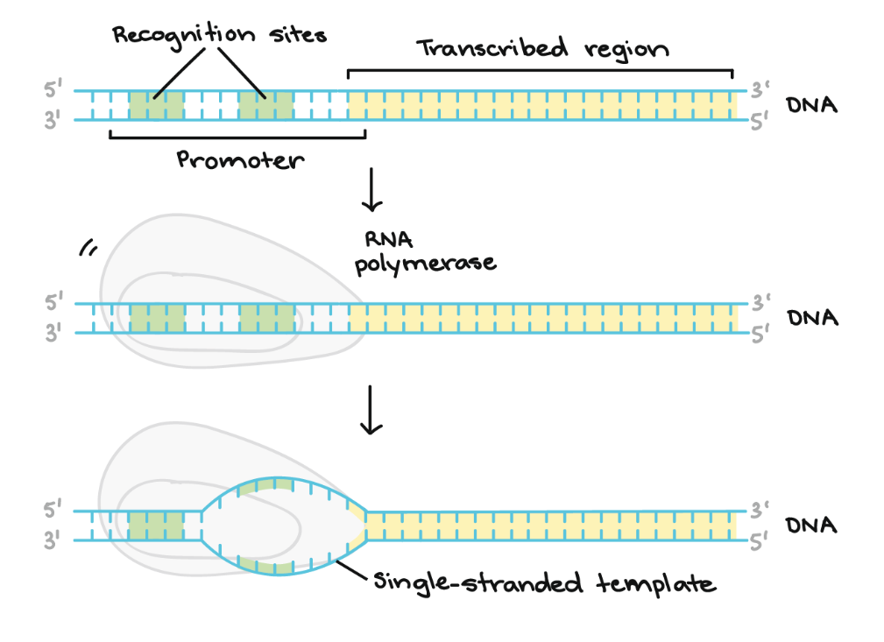
Transcription -- initiation
Image credit: Khan Academy

Slide 15
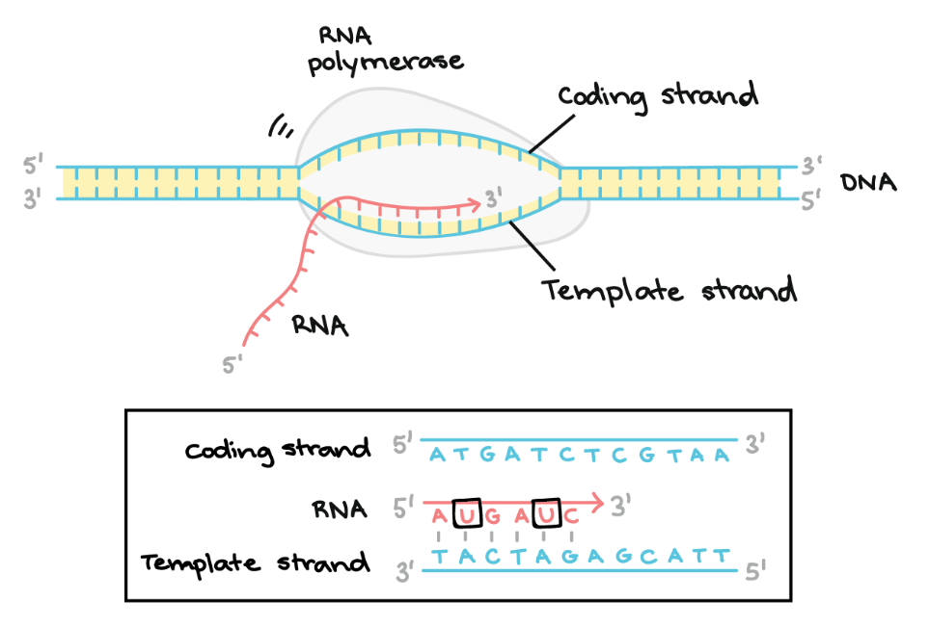
Transcription -- elongation
Image credit: Khan Academy

Slide 16
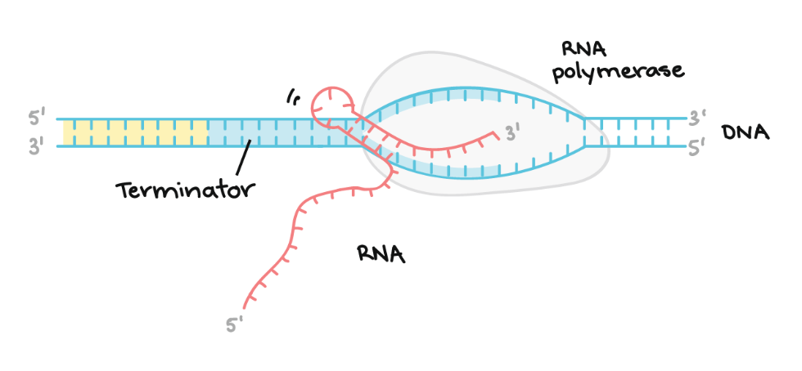
Transcription -- termination
Image credit: Khan Academy

Slide 17
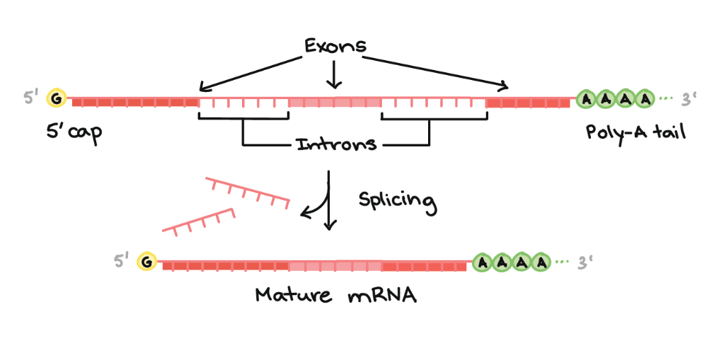
Transcription -- splicing
Image credit: Khan Academy

Slide 18
Poly-A tail
The poly-A tail is a long chain of Adenine nucleotides that is added to a messenger RNA (mRNA) molecule during RNA processing to increase the stability of the molecule
Processing of the 3' end adds a poly-A tail to the RNA molecule that is between 100 and 250 A’a long
Poly-A tail allows the mature messenger RNA molecule to be exported from the nucleus and translated into a protein by ribosomes in the cytoplasm

